Slide 1
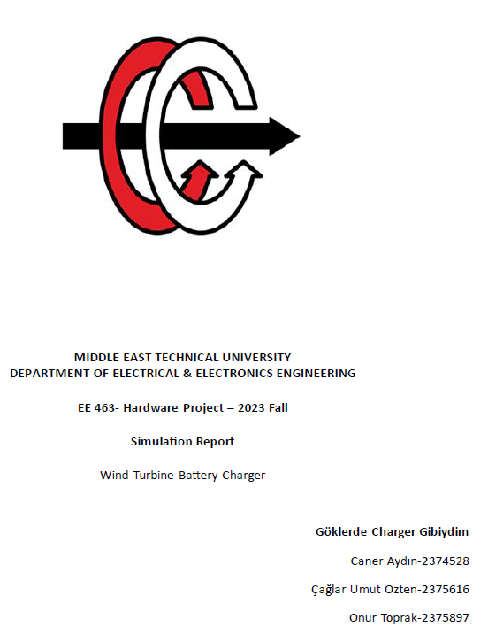

Slide 2
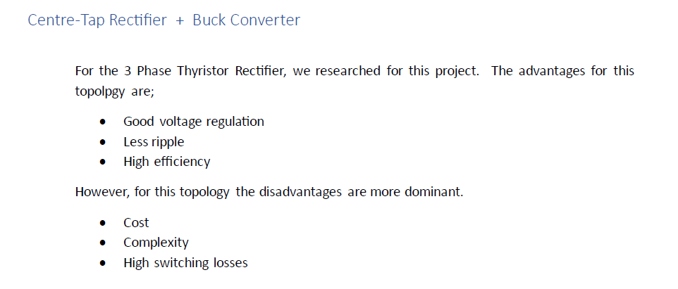

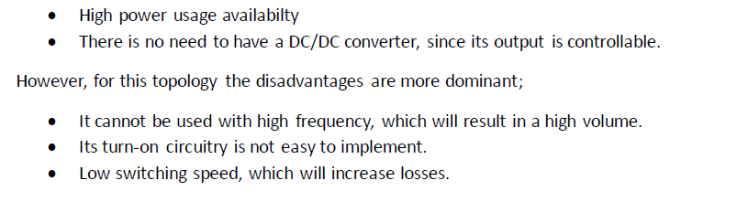
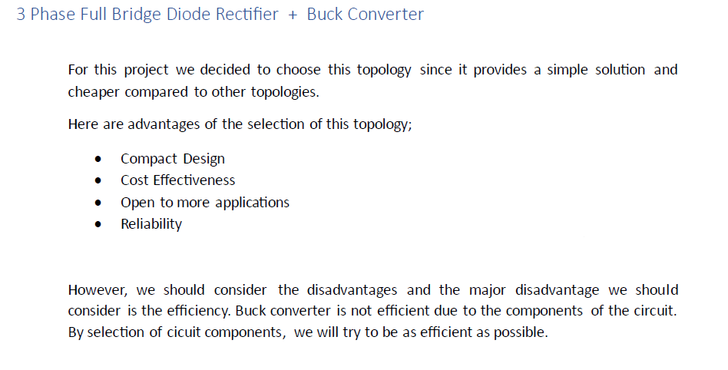

Slide 3
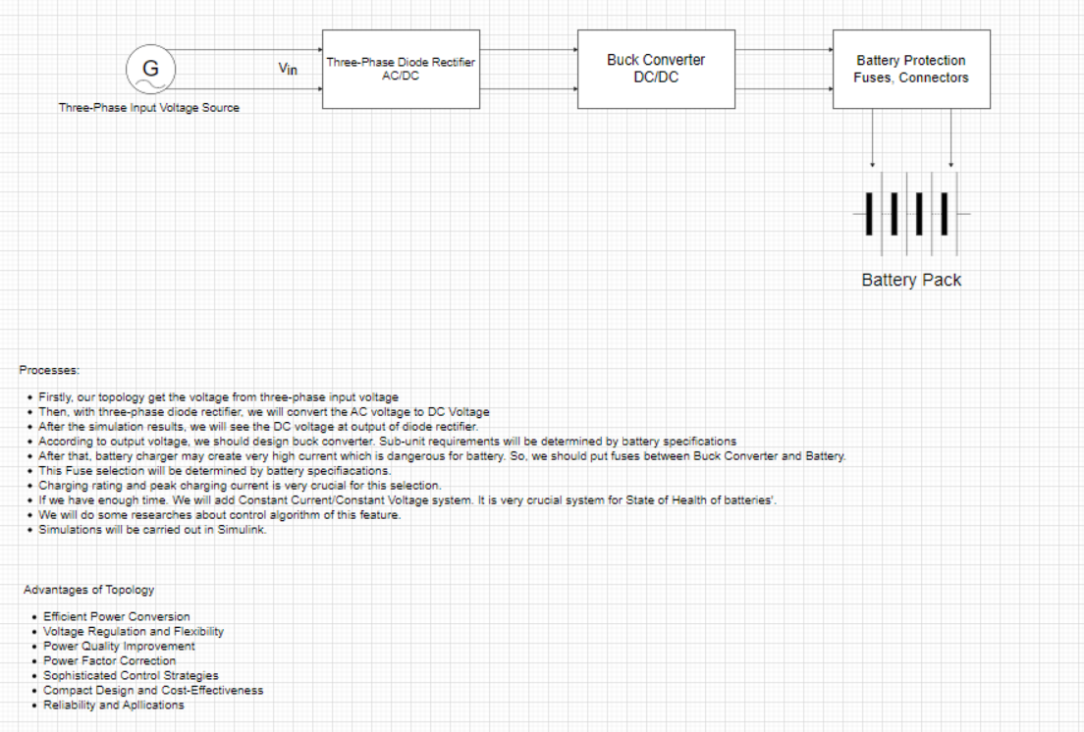

Slide 4
Overall Circuit Schematic for Battery Charger

Slide 5
Diode Current Waveforms (Maximum Input Voltage) and Diode Voltage Waveforms (Maximum Input Voltage)

Slide 6
Output Voltage Waveforms , Output Voltage Waveforms (Maximum Input Voltage)

Slide 7
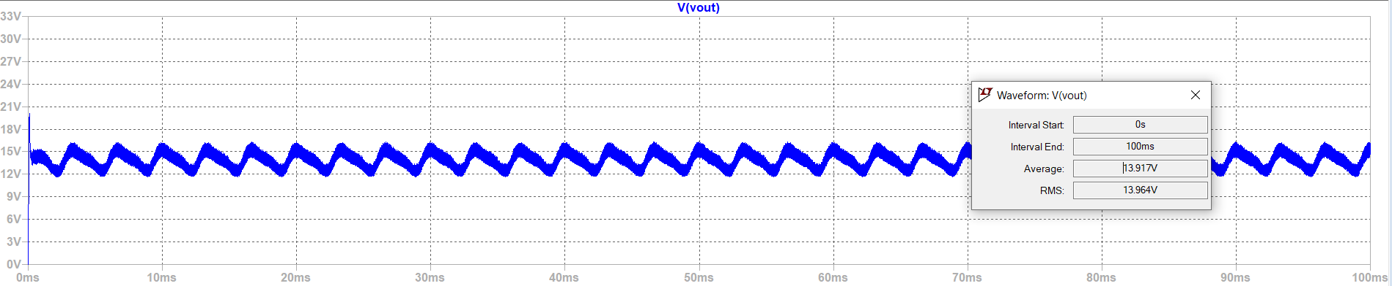
Output Voltage Waveform of Buck Converter

Slide 8
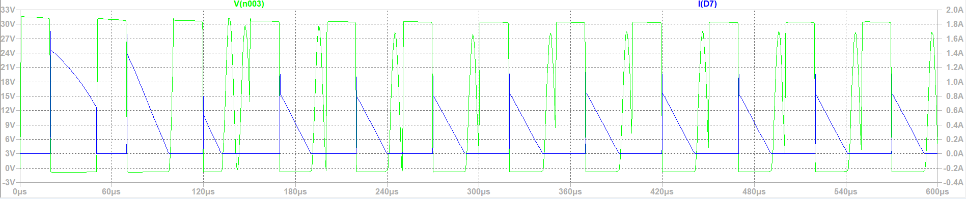
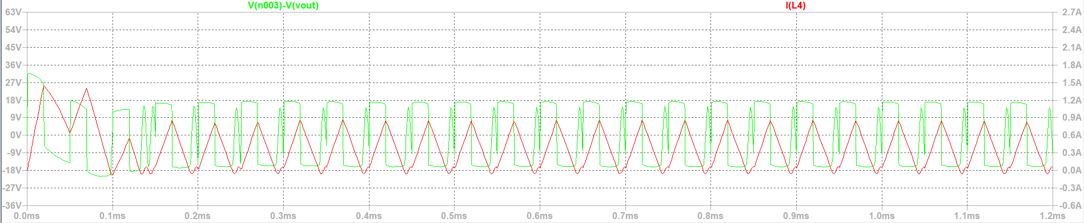
Buck Converter Voltage and Current Waveform of Inductor and Diode

Slide 9
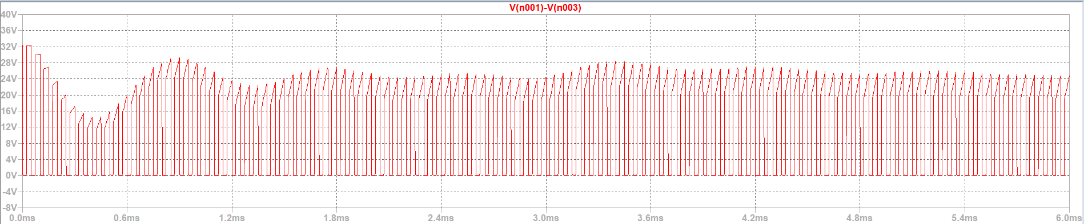
MOSFET Voltage Waveform (Vds)

Slide 10
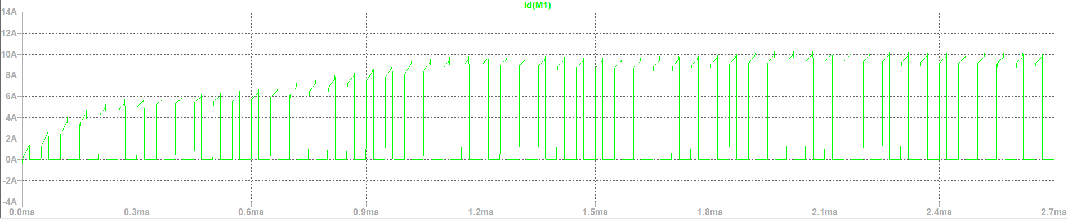
MOSFET Current Waveform (Id)

Slide 11
Gate Signal

Slide 12
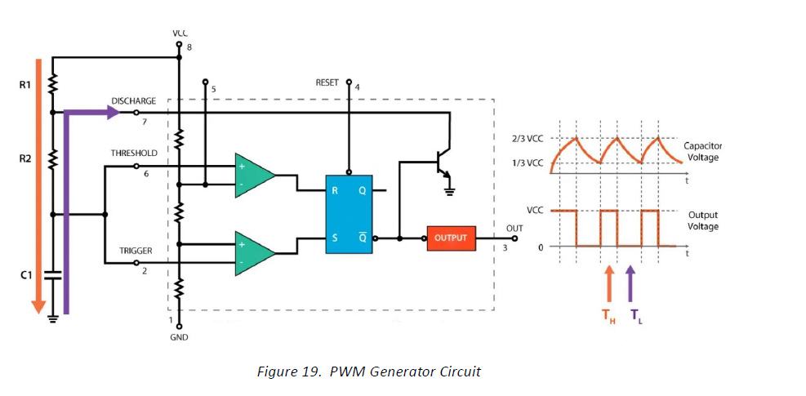
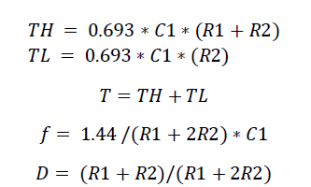
Timer Circuit LM555

Slide 13

Controller Circuit
Integrated Controller Circuit
Feedback from battery to keep Id 10 A constant.

Slide 14
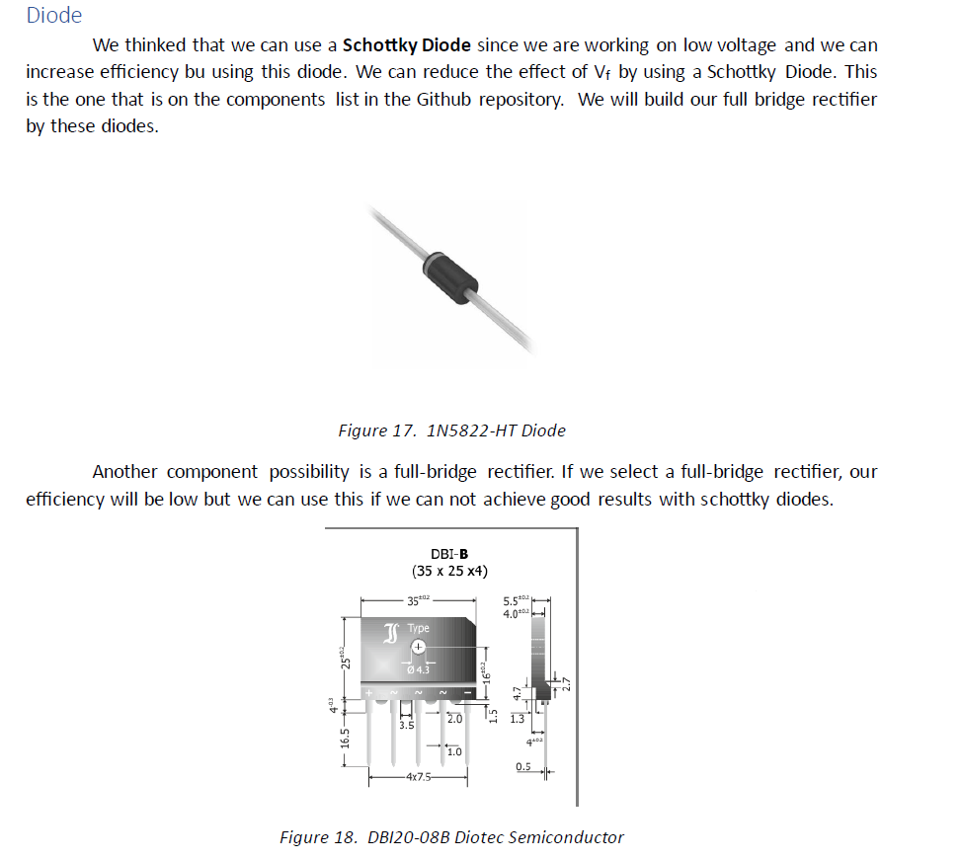
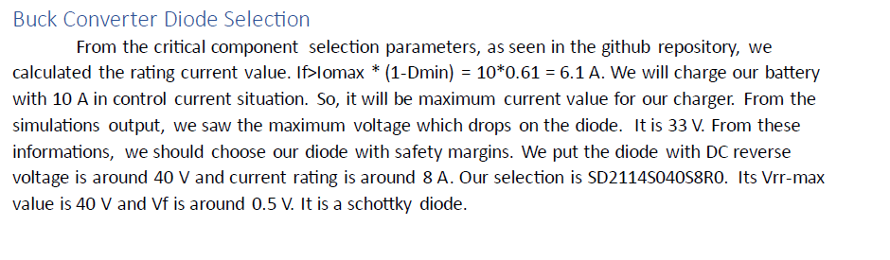
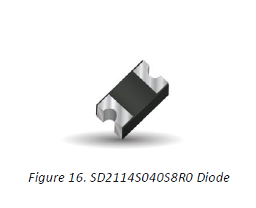
Component Selection
Diode

Slide 15
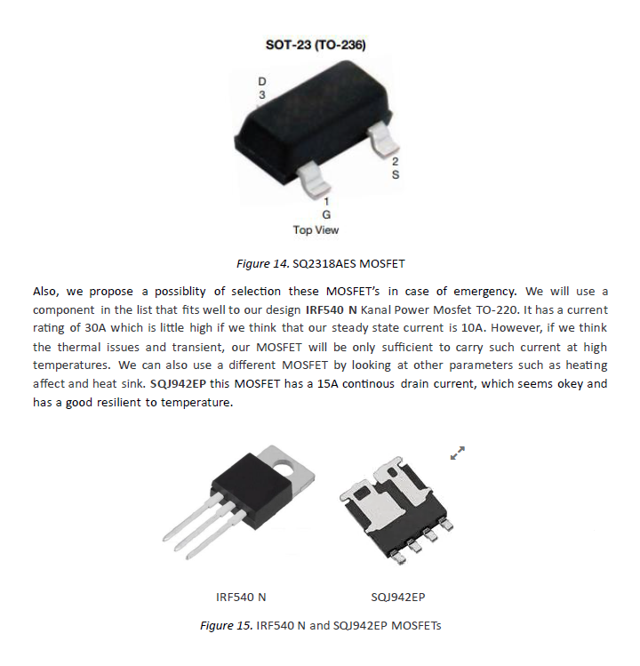
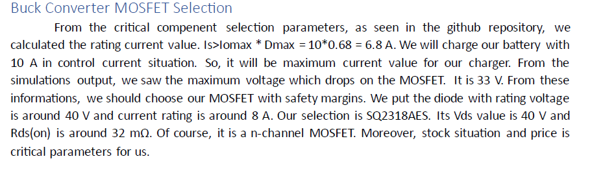
MOSFET

Slide 16

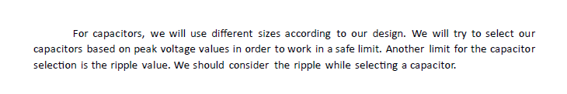

Slide 17
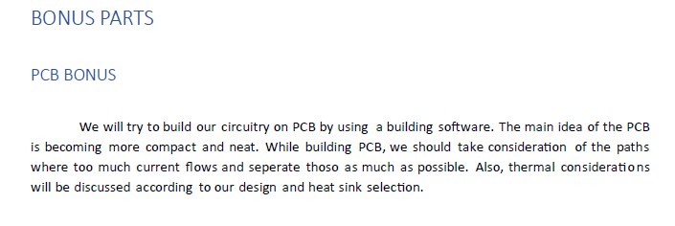
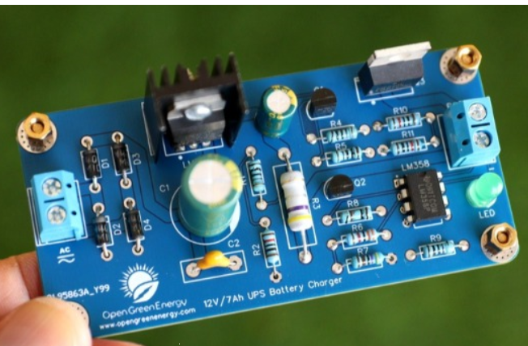
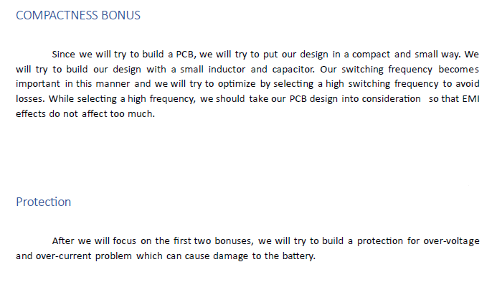
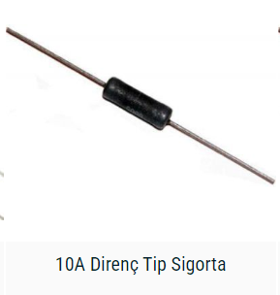
BONUS

